Slide 1
B.O.S.S
Lucas Loaiza, Siegfred Madeghe, Shang Wang, Noah Zhang

Slide 2
Introduction
01
Project Flow
02
TABLE OF CONTENTS
04
Features
Implementation Process
03
05
Demo
06
Conclusion

Slide 3
01
Introduction

Slide 4




WELCOME!
LUCAS LOAIZA
SHANG WANG
SIEGFRED MADEGHE
NOAH ZHANG
Software Developer
Quality Assurance Engineer
Software Developer
Project Manager

Slide 5
02
Project Flow

Slide 6
Timeline
Week 1
Week 2
Week 3
Week 4
Definition & Planning
Design
Development
Testing
Final touches & Presentation

Slide 7
DOCUMENTATION
Project Plan
SRS
Design Doc
Testing Plan
User Manual
Describes what the software will do, how it will be expected to perform, and the functionality the product needs to fulfill all stakeholders (business, users) needs
Describes the test strategy, objectives, schedule, estimation, deliverables, and resources required to perform testing
Defines our roles and the project timeline
A complete high-level solution to the problem presented
A guide for any user to successfully use our app

Slide 8
03
Implementation Process

Slide 9
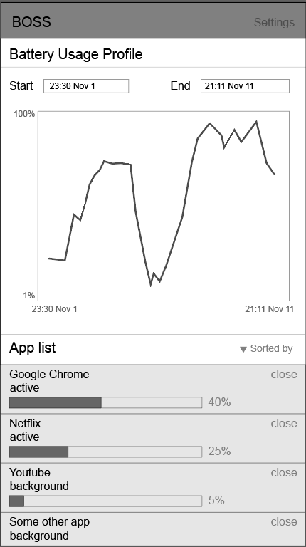
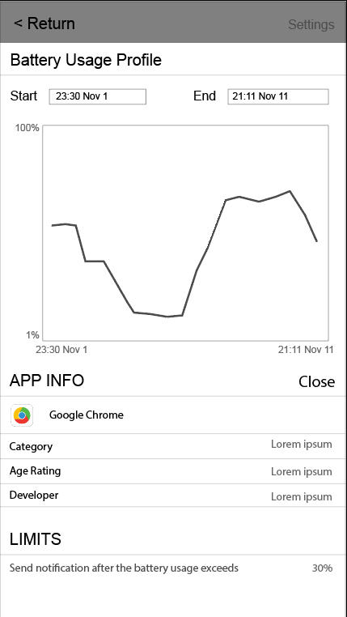
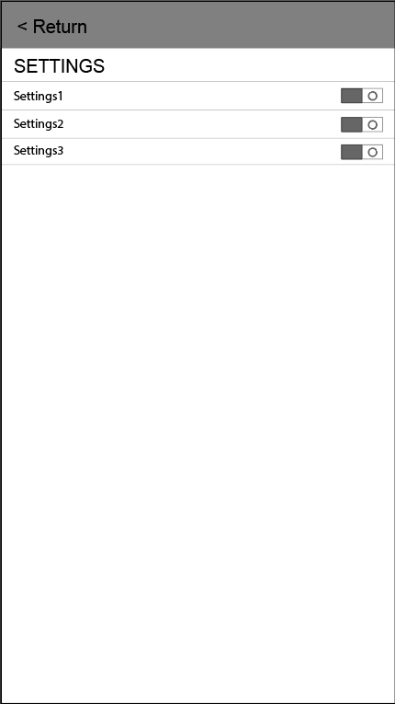
Initial UI Designs
UML

Slide 10
Initial UI Designs
UML

Slide 11
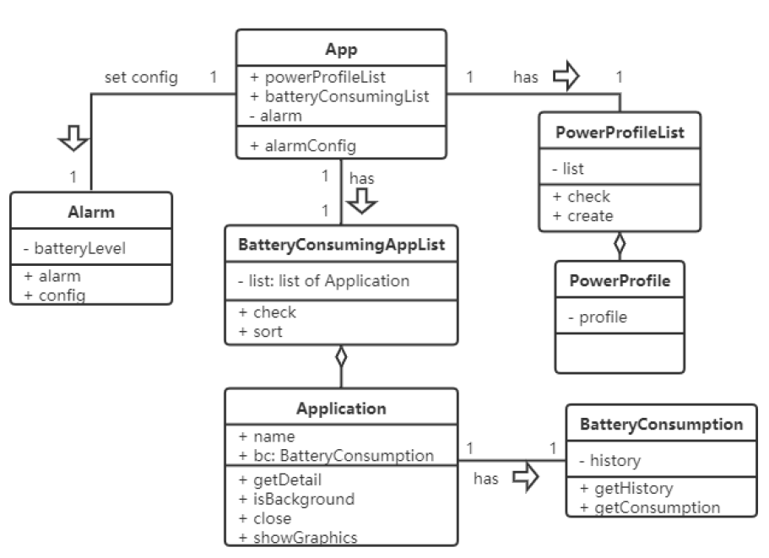
Initial UML

Slide 12
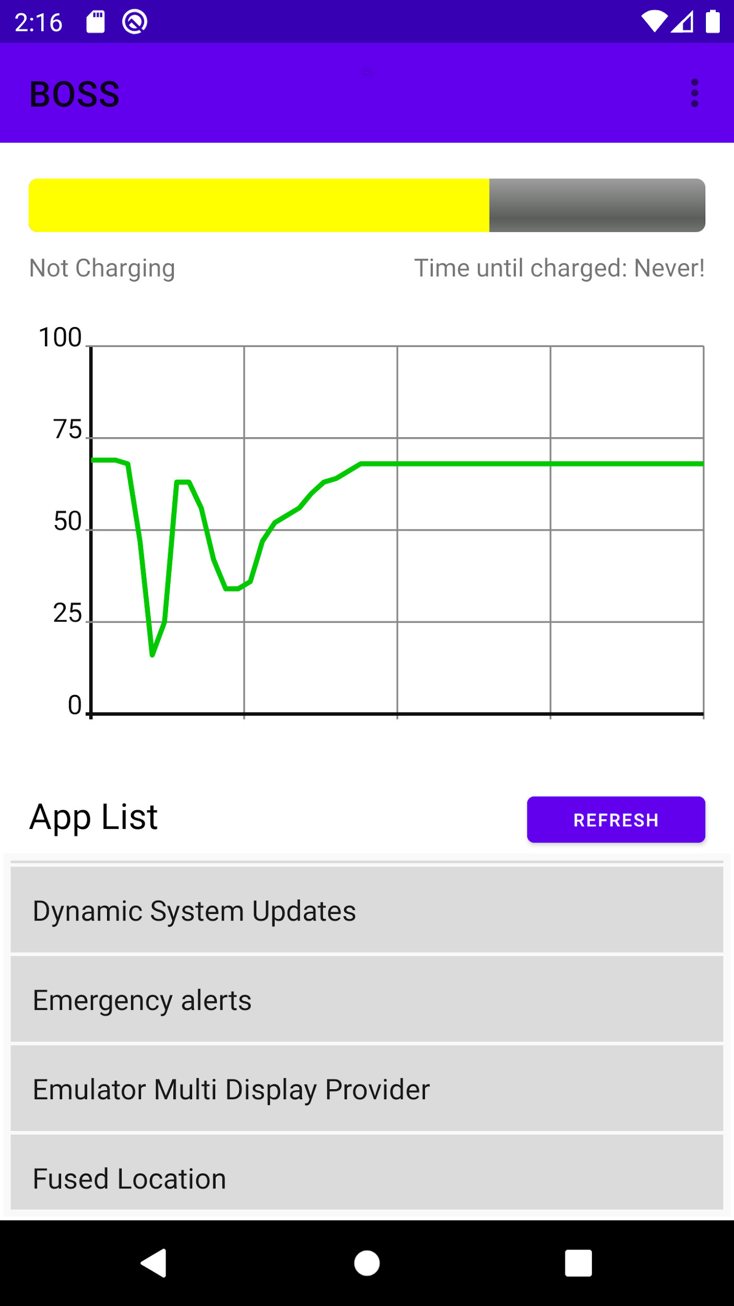
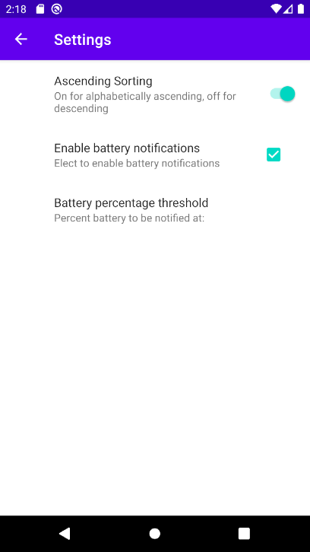
Final UI Designs and Implementation
Graphic view, app list, sorting, notification.
Monitoring the battery level on a seperate thread.
Passing message from child thread through MsgHandler to update UI.
Hold config using SharedPreferences.

Slide 13
Issues and Solutions
Performance issue
Dynamically updating chart
Process Selection
ListView Scrolling issue while updating
Updating chats, getting a list of apps, removing duplicates, and sorting are too much work for the timer thread.
Create new thread to handle battery related tasks.
Using third party package Androidplot to generate battery profile.
Using observer-observable design pattern to update charts over time.
Differentiating system-signed processes from apps.
Differentiating apps from ‘clickable’ user-level apps.
Hard coded height for the ListVeiw.
Using button click to refresh the app list.

Slide 14
04
Features

Slide 15
Key Features
List of apps using the battery
Alphabetical ordering of the app
A chart to show battery usage
Notification

Slide 16
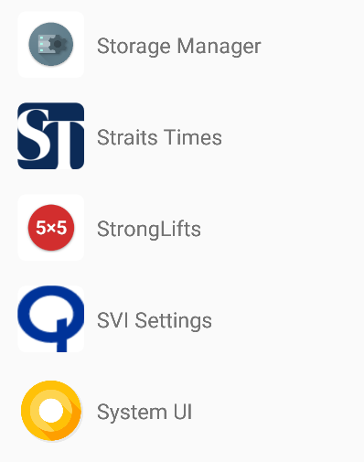
List Of Apps Using Battery
List of the apps using the battery is shown for users to monitor

Slide 17

Alphabetical Ordering
Apps can be ordered in ascending order
They can also be ordered in descending order

Slide 18
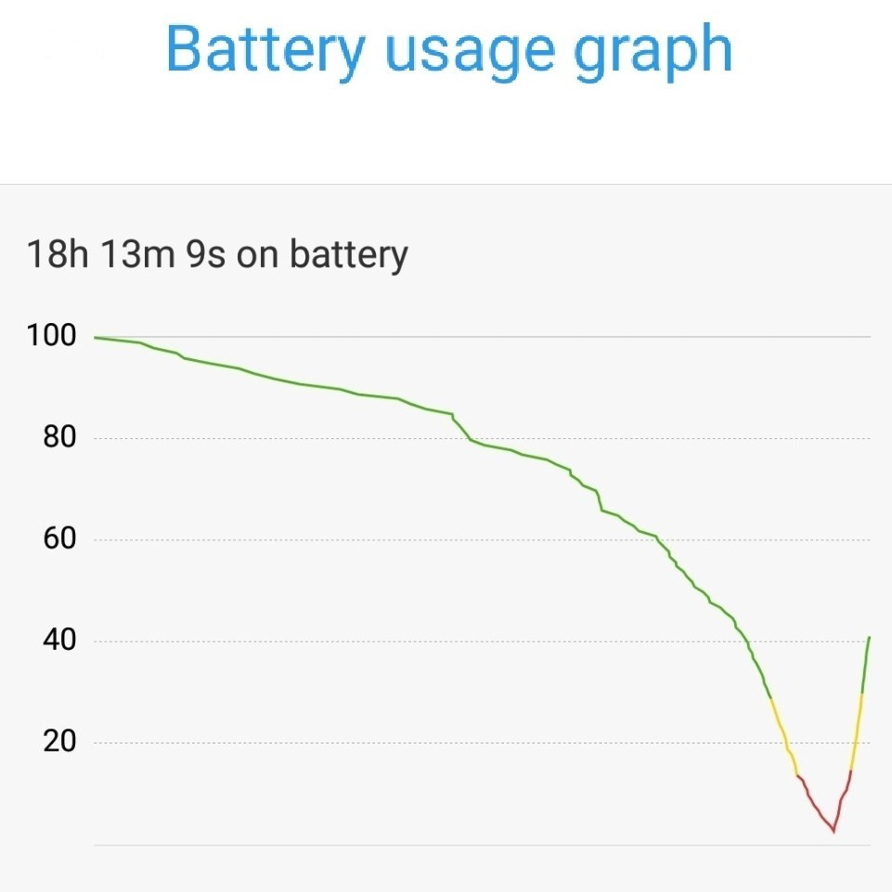
Battery Usage Chart
A chart to show battery usage by the apps

Slide 19

Notification
The app has a notification feature that alerts users about usage anomalies

Slide 20
05
Demo!

Slide 21
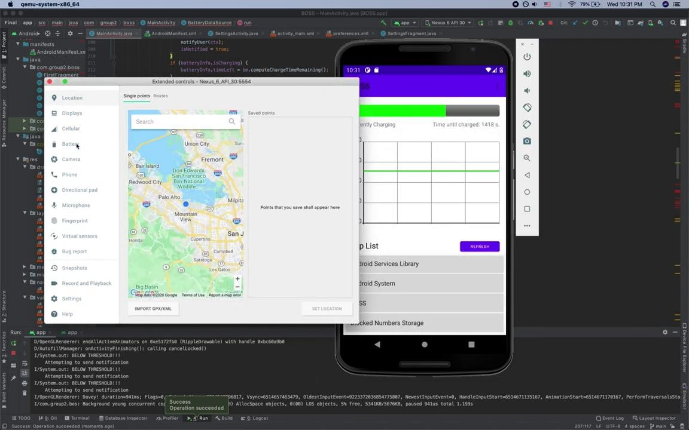

Slide 22
06
Conclusion

Slide 23
IMPROVEMENTS
App List
Smoother Scrolling
Battery Management
Safe battery mode
Saving State/Data

Slide 24
Thanks!
Questions?

